Slide 1
UNIT V (except crash recovery)
NOTE: Please refer to the PPT on CRASH RECOVERY & ARIES also for UNIT 5

Slide 2
TRANSACTIONS

Slide 3
Transactions and Concurrent Execution
Transaction (“xact”)- DBMS’s abstract view of a user program (or activity):
A sequence of reads and writes of database objects.
Unit of work that must commit or abort as an atomic unit
Transaction Manager controls the execution of transactions.
User’s program logic is invisible to DBMS!
Arbitrary computation possible on data fetched from the DB
The DBMS only sees data read/written from/to the DB.
Challenge: provide atomic transactions to concurrent users!
Given only the read/write interface.
Notes:
While one transaction is waiting for a page to be read in from disk, CPU can process another transaction. Overlapping I/O and CPU activity reduces the amount of time disk and processors are idle and increases system throughput (useful work completed per unit time)
In serial execution, a short transaction can get stuck behind a long transaction. Interleaving the execution of a short transaction with a long transaction allows the short transaction to complete quickly.
Transaction is defined as any one execution of a user program in a DBMS and differs from an execution outside the DBMS.

Slide 4
Concurrency Control & Recovery
Concurrency Control
Provide correct and highly available data access in the presence of concurrent access by many users
Recovery
Ensures database is fault tolerant, and not corrupted by software, system or media failure
24x7 access to mission critical data
A boon to application authors!
Existence of CC&R allows applications be be written without explicit concern for concurrency and fault tolerance
Notes:
Allows DMBS to have concurrent execution and recovery from system failure, esp involving mission critical data.
Users to write applications without having to worry about concurrent control and recovery. Increased programmer productivity and allows new applications to be added more easily and safely to existing system.

Slide 5
Structure of a DBMS
Query Optimization
and Execution
Relational Operators
Files and Access Methods
These layers must consider concurrency
control and recovery
(Transaction, Lock, Recovery Managers)
Buffer Management
Disk Space Management
DB

Slide 6
Concurrency: Why bother?
The latency argument
The throughput argument
Both are critical!

Slide 7
What could go wrong?
Let’s assume that before the transaction take place the balances in the account CA2090 is Rs. 50000/- and that in the account SB2359 is Rs. 35000/-.
Ti:
Read(CA2090); CA2090:=CA2090-2000;
Write (CA2090);
Read (SB2359); SB2359:=SB2359+2000;
Write (SB2359);

Slide 8
ACID properties of Transaction Executions
A tomicity: All actions in the Xact happen, or none happen.
C onsistency: If each Xact is consistent, and the DB starts consistent, it ends up consistent.
I solation: Execution of one Xact is isolated from that of other Xacts.
D urability: If a Xact commits, its effects persist.
Notes:
Transaction executions are said to respect the following 4 properties.

Slide 9
Atomicity and Durability
A.C.I.D.
A transaction ends in one of two ways:
commit after completing all its actions
“commit” is a contract with the caller of the DB
abort (or be aborted by the DBMS) after executing some actions.
Or system crash while the xact is in progress; treat as abort.
Two important properties for a transaction:
Atomicity : Either execute all its actions, or none of them
Durability : The effects of a committed xact must survive failures.
DBMS ensures the above by logging all actions:
Undo the actions of aborted/failed transactions.
Redo actions of committed transactions not yet propagated to disk when system crashes.
Notes:
1) Users should not have to worry about the effect of incomplete transactions (say when a system crash occurs)

Slide 10
Transaction Consistency
A.C.I.D.
Transactions preserve DB consistency
Given a consistent DB state, produce another consistent DB state
DB Consistency expressed as a set of declarative Integrity Constraints
CREATE TABLE/ASSERTION statements
E.g. Each CS186 student can only register in one project group. Each group must have 2 students.
Application-level
E.g. Bank account total of each customer must stay the same during a “transfer” from savings to checking account
Transactions that violate ICs are aborted
That’s all the DBMS can automatically check!
Notes:
Bank transfer example.

Slide 11
Isolation (Concurrency)
A.C.I.D.
DBMS interleaves actions of many xacts concurrently
Actions = reads/writes of DB objects
DBMS ensures xacts do not “step onto” one another.
Each xact executes as if it were running by itself.
Concurrent accesses have no effect on a Transaction’s behavior
Net effect must be identical to executing all transactions for some serial order.
Users & programmers think about transactions in isolation
Without considering effects of other concurrent transactions!
Notes:
Sees only the state of a database that could occur if the transaction were the only one running against the database and produce only the results that it could produce if it were running alone.

Slide 12
Transactions and schedules
A transaction is seen by the DBMS as a series, or list, of actions
Includes read and write of objects
We’ll write this as R(o) and W(o) (sometimes R_{T}(o) and W_{T}(o) )
For example
T1: [R(a), W(a), R(c), W(c)]
T2: [R(b), W(b)]
In addition, a transaction should specify as its final action either commit, or abort

Slide 13
Schedules
A schedule is a list of actions from a set of transactions
A well-formed schedule is one where the actions of a particular transaction T are in the same order as they appear in T
For example
[R_{T1}(a), W_{T1}(a), R_{T2}(b), W_{T2}(b), R_{T1}(c), W_{T1}(c)] is a well-formed schedule
[R_{T1}(c), W_{T1}(c), R_{T2}(b), W_{T2}(b), R_{T1}(a), W_{T1}(a)] is not a well-formed schedule

Slide 14
Schedules cont.
A complete schedule is one that contains an abort or commit action for every transaction that occurs in the schedule
A serial schedule is one where the actions of different transactions are not interleaved

Slide 15
Schedules of Transactions
A schedule S of n transactions is a sequential ordering of the operations of the n transactions.
The transactions are interleaved
A schedule maintains the order of operations within the individual transaction.
For each transaction T if operation a is performed in T before operation b, then operation a will be performed before operation b in S.
The operations are in the same order as they were before the transactions were interleaved
Two operations conflict if they belong to different transactions, AND access the same data item AND one of them is a write.
T1: R(A), W(A), R(B), W(B), C
T2: R(A), W(A), C

Slide 16
Serial and Non-serial Schedules
A schedule S is serial if, for every transaction T participating in the schedule, all of T's operations are executed consecutively in the schedule; otherwise it is called non-serial.
Non-serial schedules mean that transactions are interleaved. There are many possible orders or schedules.
Serialisability theory attempts to determine the 'correctness' of the schedules.
A schedule S of n transactions is serialisable if it is equivalent to some serial schedule of the same n transactions.

Slide 17
Anomalies with Interleaved Execution
Reading Uncommitted Data (WR Conflicts, “dirty reads”):
T1: R(A), W(A), R(B), W(B), C
T2: R(A), W(A), C

Slide 18
Example
Consider two transactions (Xacts):
T1: BEGIN A=A+100, B=B-100 END
T2: BEGIN A=1.06*A, B=1.06*B END
1st xact transfers $100 from B’s account to A’s
2nd credits both accounts with 6% interest.
Assume at first A and B each have $1000. What are the legal outcomes of running T1 and T2???
$2000 *1.06 = $2120
There is no guarantee that T1 will execute before T2 or vice-versa, if both are submitted together. But, the net effect must be equivalent to these two transactions running serially in some order.

Slide 19
Example (Contd.)
Legal outcomes: A=1166,B=954 or A=1160,B=960
Consider a possible interleaved schedule:
T1: A=A+100, B=B-100
T2: A=1.06*A, B=1.06*B
This is OK (same as T1;T2). But what about:
T1: A=A+100, B=B-100
T2: A=1.06*A, B=1.06*B
Result: A=1166, B=960; A+B = 2126, bank loses $6
The DBMS’s view of the second schedule:
T1: R(A), W(A), R(B), W(B)
T2: R(A), W(A), R(B), W(B)

Slide 20
Anomalies with Interleaved Execution
Unrepeatable Reads (RW Conflicts):
T1: R(A), W(A), C
T2: R(A), W(A), C

Slide 21
Anomalies (Continued)
Overwriting Uncommitted Data (WW Conflicts): Lost Update Problem
Involves blind write
T1: W(A), W(B), C
T2: W(A), W(B), C

Slide 22
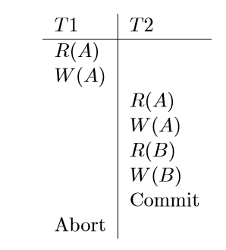
Schedules involving Aborted Transactions
A recoverable schedule is one in which transactions commit only after (and if!) all transactions whose changes they read commit.
A schedule is said to be strict if a value written by a transaction T is not read or overwritten by other transactions until T either aborts or commits.
If transactions read only the changes of committed transactions, not only is the schedule recoverable, but also aborting a transaction can be accomplished without cascading the abort to other transactions. Such a schedule is said to avoid cascading aborts.

Slide 23
Lock Based Concurrency Control
A schedule must be serializable, recoverable and actions of committed transactions must not be lost
DBMS uses a locking protocol to achieve this
A lock is bookkeeping object associated with each database object
A locking protocol is a set of rules followed by each transaction to ensure that the net effect of interleaved transactions is the same as executing all transactions serially.

Slide 24
2PL, SERIALIZABILITY AND RECOVERABILITY

Slide 25
Scheduling Transactions
Serial schedule: A schedule that does not interleave the actions of different transactions.
i.e., you run the transactions serially (one at a time)
Equivalent schedules: For any database state, the effect (on the set of objects in the database) and output of executing the first schedule is identical to the effect of executing the second schedule.
Serializable schedule: A schedule that is equivalent to some serial execution of the transactions.
Intuitively: with a serializable schedule you only see things that could happen in situations where you were running transactions one-at-a-time.

Slide 26
Locks
We use “locks” to control access to items.
Shared (S) locks – multiple transactions can hold these on a particular item at the same time.
Exclusive (X) locks – only one of these and no other locks, can be held on a particular item at a time.
 | S | X
S | √ | –
X | – | –
Lock
Compatibility
Matrix

Slide 27
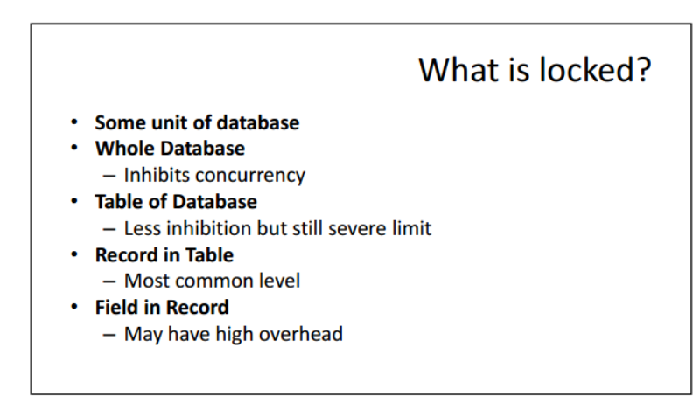

Slide 28
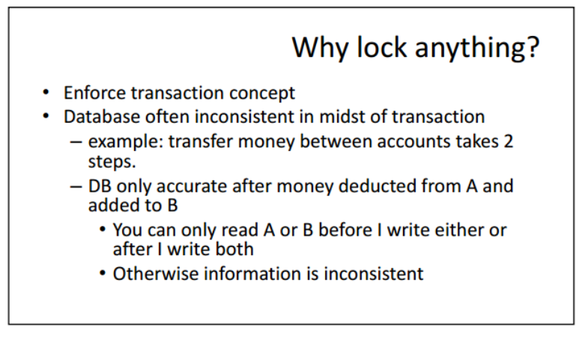

Slide 29
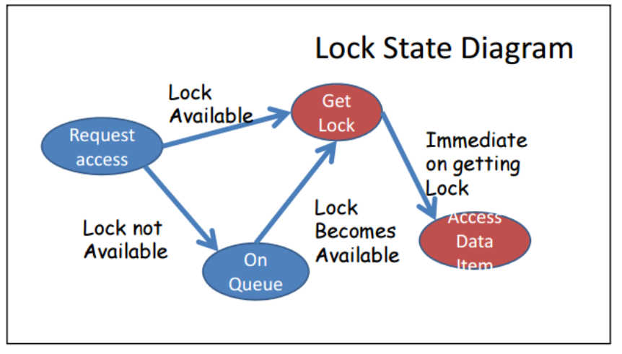

Slide 30
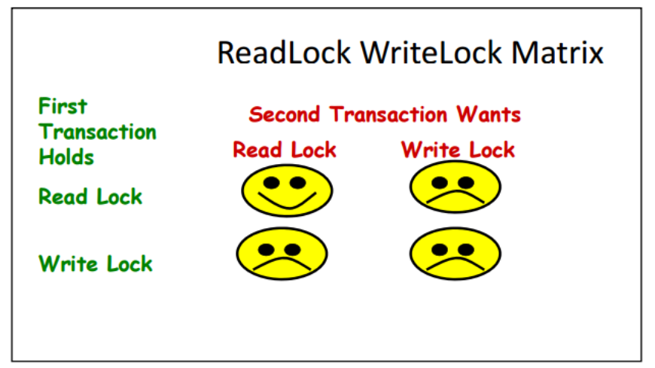

Slide 31
Lock-Based Concurrency Control
Here’s a simple way to allow concurrency but avoid the anomalies just described…
Strict Two-phase Locking (Strict 2PL) Protocol:
Each transaction must obtain an S (shared) lock on object before reading, and an X (exclusive) lock on object before writing.
System can obtain these locks automatically
Lock rules:
If an transaction holds an X lock on an object, no other transaction can acquire a lock (S or X) on that object
If an transaction holds an S lock, no other transaction can get an X lock on that object.
All locks held by a transaction are released when the transaction completes
Strict 2PL allows only serializable and recoverable schedules.

Slide 32
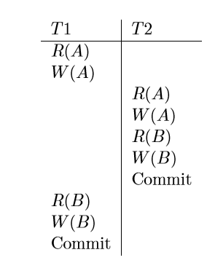
T1 | T2
X(A)
R(A)
W(A)
X(B)
R(B)
W(B)
Commit
 | X(A)
 | R(A)
 | W(A)
 | X(B)
 | W(B)
 | Commit

Slide 33
Interleaved Schedule Following Strict 2PL
T1 | T2
S(A)
R(A)
 | S(A)
 | R(A)
 | X(B)
 | R(B)
 | W(B)
 | Commit
X(C)
R(C)
W(C)
Commit

Slide 34
Lock-Based Concurrency Control
Two-phase Locking (2PL) Protocol:
Always obtain a S (shared) lock on object before reading
Always obtain an X (exclusive) lock on object before writing.
If an Xact holds an X lock on an object, no other Xact can get a lock (S or X) on that object.
DBMS internally enforces the above locking protocol
Two phases: acquiring locks, and releasing them
No lock is ever acquired by a transaction after one has been released
“Growing phase” followed by “shrinking phase”.
Lock Manager tracks lock requests, grants locks on database objects when they become available.

Slide 35
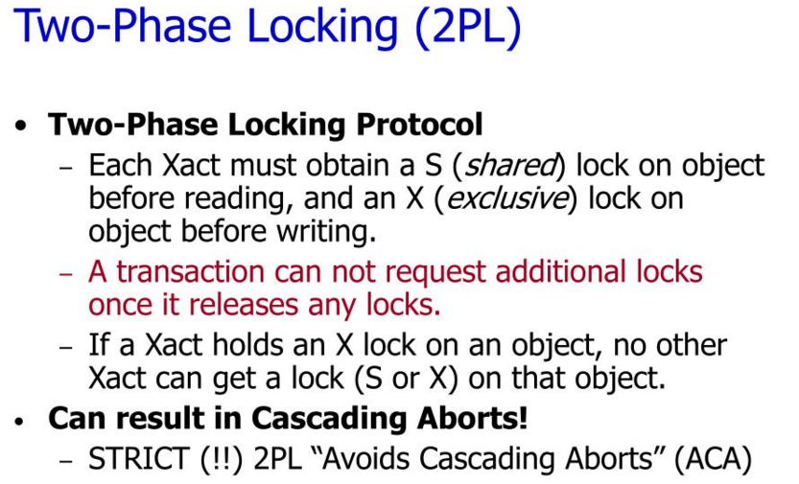

Slide 36
Strict schedules
A schedule is said to be strict if a value written by a transaction T is not read or overwritten by other transactions until T either aborts or commits.
They are recoverable.
They do not require cascading aborts.
Actions of aborted transactions can be undone by restoring the original values of modified objects.

Slide 37
Conflict Serializable Schedules
We need a formal notion of equivalence that can be implemented efficiently…
Two operations conflict if they are by different transactions, they are on the same object, and at least one of them is a write.
Two schedules are conflict equivalent iff:
They involve the same actions of the same transactions, and
every pair of conflicting actions is ordered the same way
If two schedules are conflict equivalent then they have the same effect on a database
Schedule S is conflict serializable if S is conflict equivalent to some serial schedule.
Note, some “serializable” schedules are NOT conflict serializable.
This is the price we pay for efficiency.

Slide 38
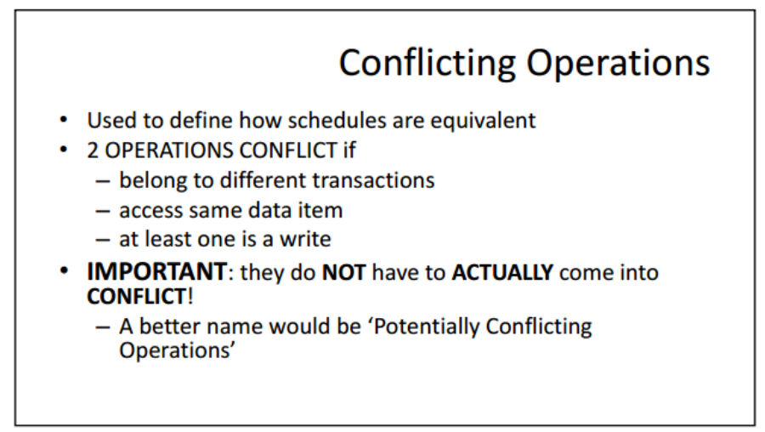

Slide 39
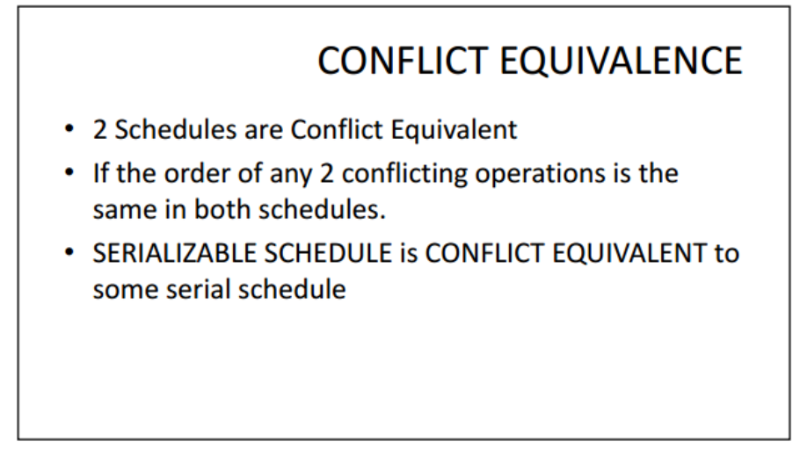

Slide 40
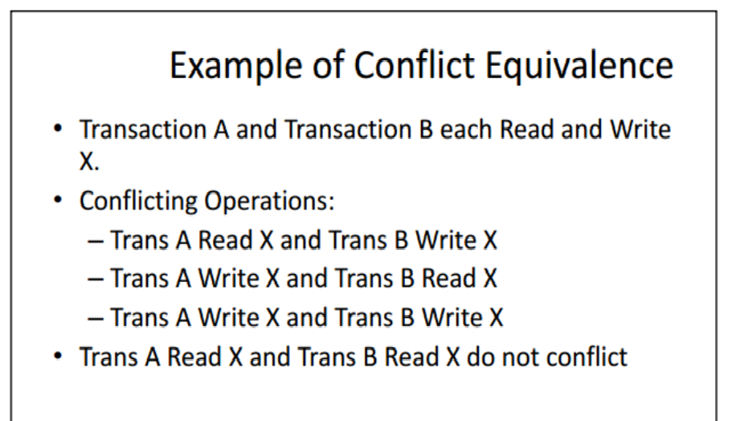

Slide 41
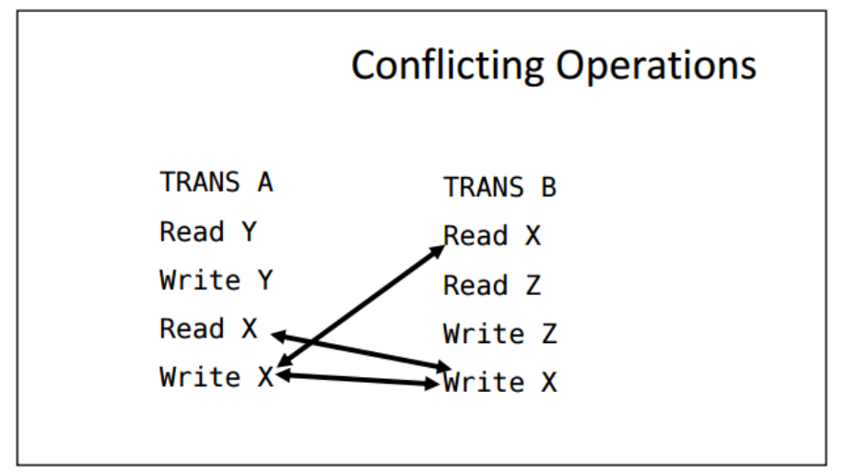

Slide 42
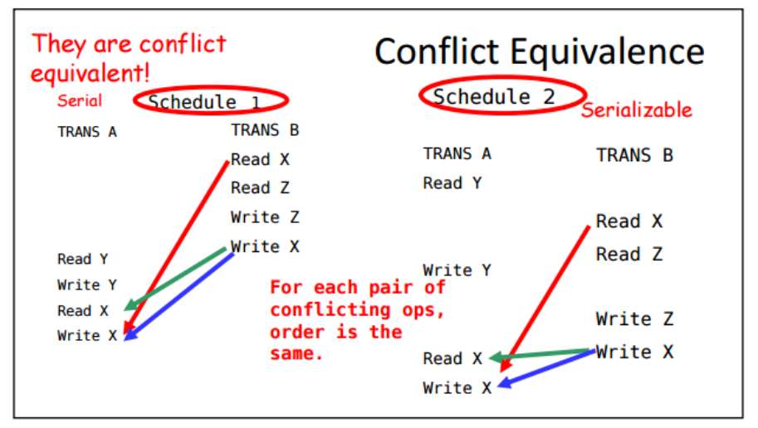

Slide 43
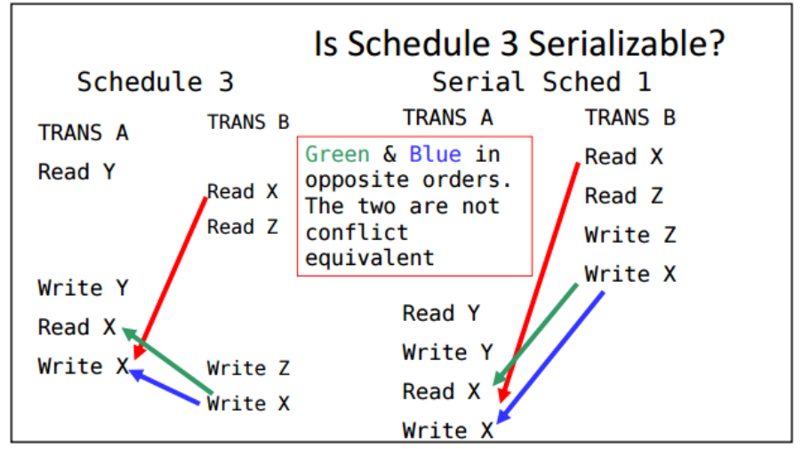

Slide 44
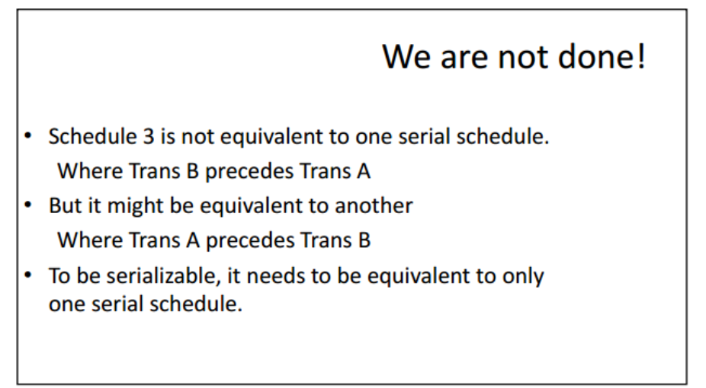

Slide 45
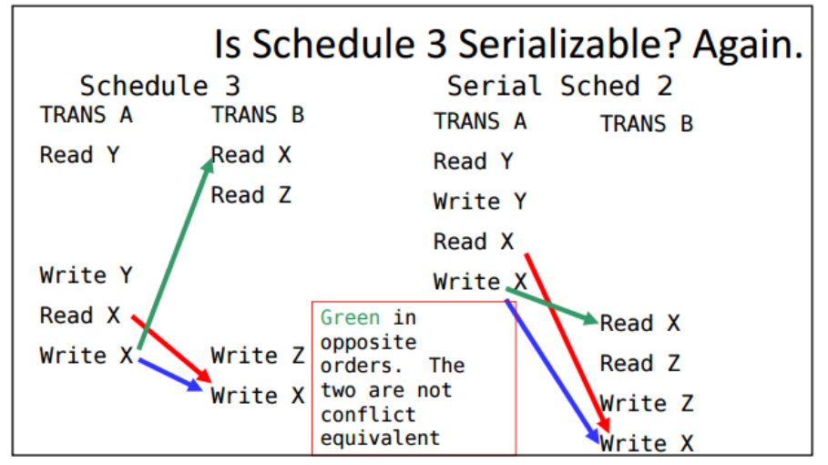

Slide 46
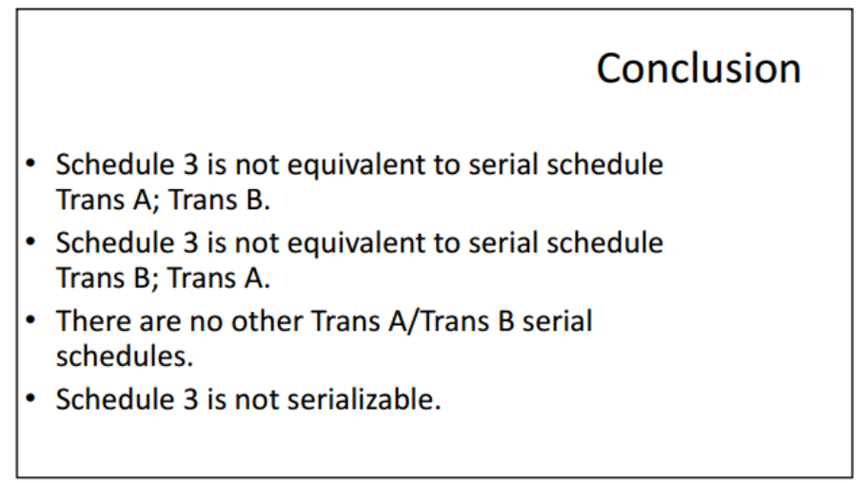

Slide 47
Dependency Graph
Precedence graph/Serializability graph:
One node per transaction in S;
edge from Ti to Tj if an operation of Ti conflicts with an operation of Tj and Ti’s operation appears earlier in the schedule than the conflicting operation of Tj.
Theorem: Schedule is conflict serializable if and only if its dependency graph is acyclic

Slide 48
(…cont’d) Precedence Graph
A schedule is conflict serializable if and only if its
precedence graph is acyclic.
Strict 2PL ensures that the precedence for any schedule that it allows is acyclic.

Slide 49
Example
A schedule that is not conflict serializable:
The cycle in the graph reveals the problem. The output of T1 depends on T2, and vice-versa.
T1: R(A), W(A), R(B), W(B)
T2: R(A), W(A), R(B), W(B)
T1: R(A), W(A), R(B), W(B)
T2: R(A), W(A), R(B), W(B)
T1: R(A), W(A), R(B), W(B)
T2: R(A), W(A), R(B), W(B)
T1: R(A), W(A), R(B), W(B)
T2:
T1: R(A), W(A), R(B), W(B)
T2: R(A), W(A), R(B), W(B)
A
T1
T2
Dependency graph
B

Slide 50
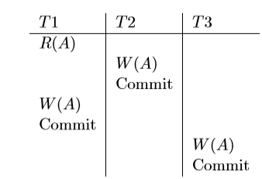
Examples of Precedence Graphs
T1 T2 T1 T2
X(A) X(A)
R(A) R(A)
W(A) W(A)
X(B) X(B)
R(B) R(B)
Commit W(B)
X(A) Commit
R(A) X(C)
W(A) R(C)
X(B) W(C)
R(B) Commit
W(B)
Commit Figure 3 Strict 2PL with Interleaved Actions
Figure 2 Strict 2PL with Serial
Execution

Slide 51
Precedence Graph
The precedence graph for a schedule S contains:
A node for each committed transaction in S.
A arc from Ti to Tj if an action of Ti precedes and conflicts
with one of Tj’s actions.
The precedence graphs for schedules corresponding to
Figure 2, Figure 3, and Figure 4(respectively (i),(ii), (iii) ):
(i) (ii)
(iii)
T1
T2
T1
T2
T1
T2
T3

Slide 52
For each of the following schedules, determine to which of the classes “recoverable”, “ACA”, “strict” it belongs to:
S1: w1(x) w2(y) r1(x) c1 r2(x) c2 w3(y) c3
S2: w1(x) r2(y) r1(x) r2(x) c1 w2(y) c2
S3: w1(x) r2(y) r2(x) r1(x) c2 w1(y) c1
S4: w1(x) w3(y) c1 r2(x) r3(y) w3(x) c3 w2(y) c2

Slide 53
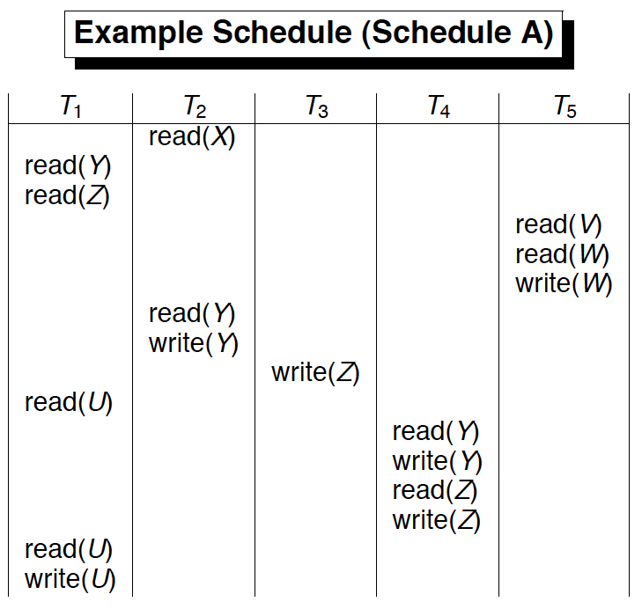
Time dim
r2(x) r1(y) r1(z) r5(v) r5(w) w5(w)….

Slide 54
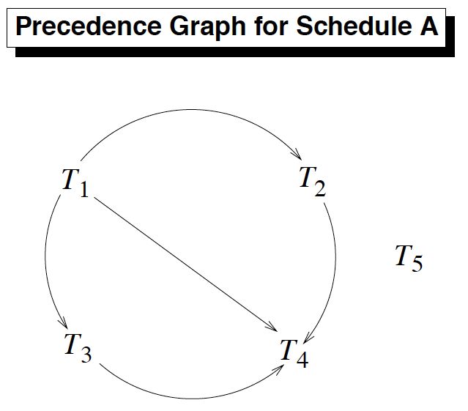
Build P(A)
No cycles
Schedule A is Conflict Serializable

Slide 55
Exercise 1:
What is P(S) for S = w3(A) w2(C) r1(A) w1(B) r1(C) w2(A) r4(A) w4(D)
Is S conflict-serializable?

Slide 56
Exercise 2:
What is P(S) for S = w1(A) r2(A) r3(A) w4(A) ?
Is S conflict-serializable?

Slide 57
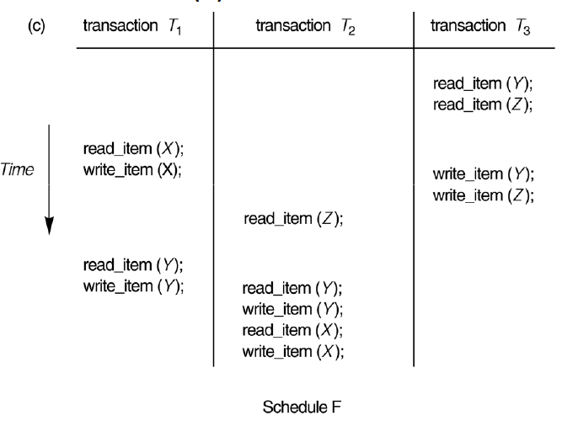
Exercise 3:
Build P(F)….Is F Conflict Serializable ?

Slide 58
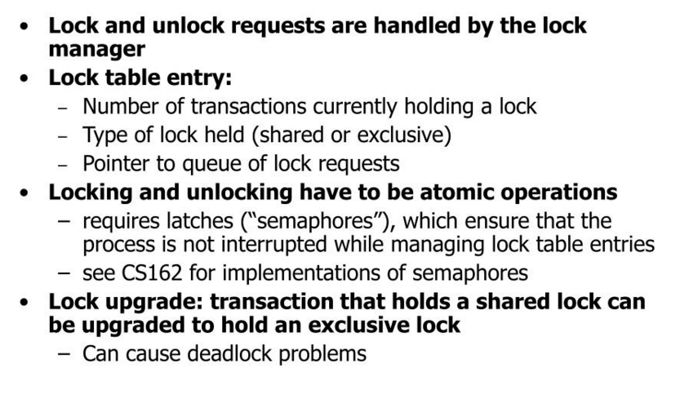
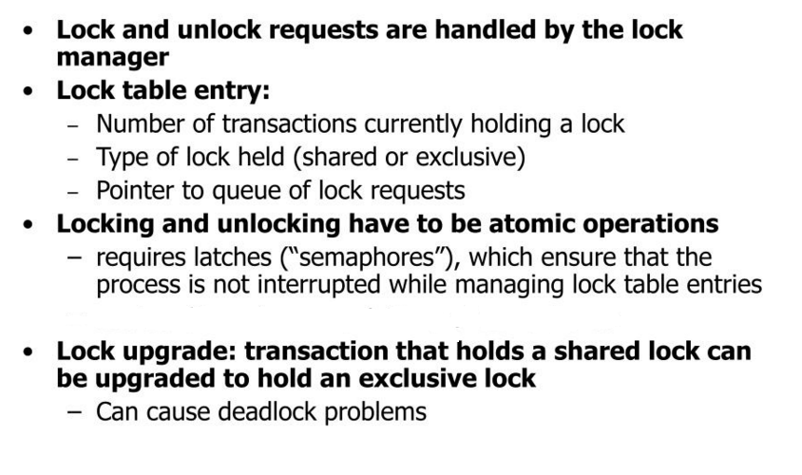
Lock Management

Slide 59
Lock and Unlock Requests
When a transaction needs a lock on an object, it issues a
lock request to the lock manager.
When a transaction aborts or commits, it releases all its
locks.
The implementation of lock and unlock commands must ensure that these are atomic operations.
A transaction holding a heavily used lock may be suspended by the operating system.

Slide 60
Implementing Lock requests
When a transaction needs a lock on an object, it issues a lock request to the lock manager:
If a shared lock is requested, the queue of requests is empty, and the object is not currently locked in exclusive mode, the lock manager grants the lock and updates the lock table entry for the object.
If an excusive lock is requested and no transaction currently holds a lock on the object, the lock manager grants the lock and updates the lock table entry.
Otherwise, the requested lock cannot be granted immediately, and the lock request is added to the queue of lock requests for this object. The transaction requesting the lock is suspended.

Slide 61
Implementing Unlock requests
When a transaction aborts or commits, it releases all its locks.
When a lock on an object is released, the lock manager updates the lock table entry for the object and examines the lock request at the head of the queue for this object.
If this request can now be granted, the transaction that made the request is woken up and given the lock.
If several requests for a shared lock on the object are at the front of the queue, all of these requests can now be granted together.

Slide 62
View Serializability
Two schedules S1 and S2 over the same set of transactions, are view equivalent if
1. If T_{i} reads the initial value of object A in S1, it must also read the initial value of A in S2.
2. If T_{i} reads a value of A written by T_{j} in S1, it must also read the value of A written by T_{j} in S2.
3. For each data object A, the transaction that performs the final write on A in S1 must also perform the final write on A in S2.
* A schedule is view serializable if it is view equivalent to some serial schedule.
* Every conflict serializable schedule is view serializable; but the converse is not true.
* Any view serializable schedule that is not conflict serializable contains a blind write.

Slide 63
Latches:
In addition to long duration locks, DBMS also supports short duration latches.
Setting a latch before reading or writing ensures that the physical read or write operation is atomic.
Latches are unset immediately after the physical read or write operation is completed.
Convoys:
Here, most of the CPU cycles are spent on process switching.
A transaction holding a heavily used lock may be suspended by the Operating System. Until it is resumed, every other transaction that needs this lock is queued.
They do not support preemptive scheduling.

Slide 64
Lock Conversions
A transaction may need to acquire an exclusive lock on an object for which it already holds a shared lock.
This lock upgrade request is handled by granting the exclusive lock immediately if no other transaction holds a shared lock on the object, otherwise by inserting the request at the front of the queue.
This lock upgrade request may lead to the deadlocks.
This is avoided by obtaining exclusive locks initially, and then downgrading to a shared lock once it is clear that this is sufficient.
Downgrading approach reduces concurrency. However, it improves throughput by reducing deadlocks.
The concurrency can be increased by introducing update lock.

Slide 65
Deadlock
Deadlock is a cycle of transactions that are all waiting for another transaction in the cycle to release a lock.
The DBMS must either prevent or detect (and resolve) deadlock situations.
We can prevent deadlock by giving each transaction a priority ( e.g., assign timestamp) and ensuring that lower priority transactions are not allowed to wait for higher priority transactions (or vice-versa).
Detecting and resolving deadlocks as they arise has advantage over taking measures to prevent deadlock, because deadlocks tend to be rare. The lock manager maintains a waits-for graph to detect deadlock cycles.

Slide 66
Dealing with deadlocks
When a transaction T_{i} is suspended because a lock that it requests cannot be granted, it must wait until all transactions T_{j} that currently hold conflicting locks release them.
The lock manager maintains a waits-for graph to detect deadlock cycles. Here,
The nodes correspond to active transactions.
The arc from T_{i} to T_{j} indicates that T_{i} is waiting for T_{j} to release a lock.
The lock manager adds edges to the graph when it queues lock requests, and removes edges when grants lock requests.
A cycle indicates a deadlock.

Slide 67
Schedule illustrating deadlock:
T1
S(A)
R(A)
S(B)
T2
X(B)
W(B)
X(C)
T3
S(C)
R(C)
X(A)
T4
X(B)

Slide 68
Waits-for graph:
T1
T2
T1
T2
T4
T3
T4
T3
Before Deadlock
After Deadlock

Slide 69
Deadlock Prevention
Deadlocks can be prevented by giving each transaction a priority.
A way to assign priorities is to give each transaction a timestamp when it starts up. The lower the timestamp, the higher is the transaction’s priority.
If a transaction T_{i} requests a lock and transaction T_{j} holds a conflicting lock, the lock manager can use one of the following policies:
Wait – die
Wound - wait

Slide 70
Wait – die:
If T_{i} has the higher priority, it is allowed to wait; otherwise, it is aborted.
Lower priority transactions can never wait for higher priority transactions.
It is nonpreemptive.
Wound – wait:
If T_{i} has higher priority, abort T_{j}; otherwise, T_{i} waits.
Higher priority transactions never wait for lower priority transactions.
It is preemptive.

Slide 71
Deadlock Prevention
Deadlocks can also be prevented by Conservative 2PL.
Here, a transaction obtains all the locks it will ever need when it begins, or blocks waiting for those locks to become available.
Here, a transaction that already holds some locks will not block waiting for other locks.

Slide 72
Security and Authorization
Notes:
1
The slides for this text are organized into chapters. This lecture covers Chapter 21, and discusses database security, including SQL support for access control, and issues in allowing access to databases over a network.
The material on Mandatory Access Control and later slides can be omitted at the instructor’s discretion in an introductory course.

Slide 73
Introduction to DB Security
Secrecy: Users should not be able to see things they are not supposed to.
E.g., A student can’t see other students’ grades.
Integrity: Users should not be able to modify things they are not supposed to.
E.g., Only instructors can assign grades.
Availability: Users should be able to see and modify things they are allowed to.

Slide 74
Access Controls
A security policy specifies who is authorized to do what.
A security mechanism allows us to enforce a chosen security policy.
Two main mechanisms at the DBMS level:
Discretionary access control
Mandatory access control

Slide 75
Discretionary Access Control
Based on the concept of access rights or privileges for objects (tables and views), and mechanisms for giving users privileges (and revoking privileges).
Creator of a table or a view automatically gets all privileges on it.
DMBS keeps track of who subsequently gains and loses privileges, and ensures that only requests from users who have the necessary privileges (at the time the request is issued) are allowed.

Slide 76
GRANT Command
GRANT privileges ON object TO users [WITH GRANT OPTION]
The following privileges can be specified:
SELECT: Can read all columns (including those added later via ALTER TABLE command).
INSERT(col-name): Can insert tuples with non-null or non-default values in this column.
INSERT means same right with respect to all columns.
DELETE: Can delete tuples.
REFERENCES (col-name): Can define foreign keys (in other tables) that refer to this column.
If a user has a privilege with the GRANT OPTION, can pass privilege on to other users (with or without passing on the GRANT OPTION).
Only owner can execute CREATE, ALTER, and DROP.

Slide 77
GRANT and REVOKE of Privileges
GRANT INSERT, SELECT ON Sailors TO Horatio
Horatio can query Sailors or insert tuples into it.
GRANT DELETE ON Sailors TO Yuppy WITH GRANT OPTION
Yuppy can delete tuples, and also authorize others to do so.
GRANT UPDATE (rating) ON Sailors TO Dustin
Dustin can update (only) the rating field of Sailors tuples.
GRANT SELECT ON ActiveSailors TO Guppy, Yuppy
This does NOT allow the users to query Sailors directly!
REVOKE: When a privilege is revoked from X, it is also revoked from all users who got it solely from X.
Notes:
23

Slide 78
GRANT/REVOKE on Views
If the creator of a view loses the SELECT privilege on an underlying table, the view is dropped!
If the creator of a view loses a privilege held with the grant option on an underlying table, (s)he loses the privilege on the view as well; so do users who were granted that privilege on the view!

Slide 79
Views and Security
Views can be used to present necessary information (or a summary), while hiding details in underlying relation(s).
Given ActiveSailors, but not Sailors or Reserves, we can find sailors who have a reservation, but not the bid’s of boats that have been reserved.
Creator of view has a privilege on the view if (s)he has the privilege on all underlying tables.
Together with GRANT/REVOKE commands, views are a very powerful access control tool.
Notes:
22

Slide 80
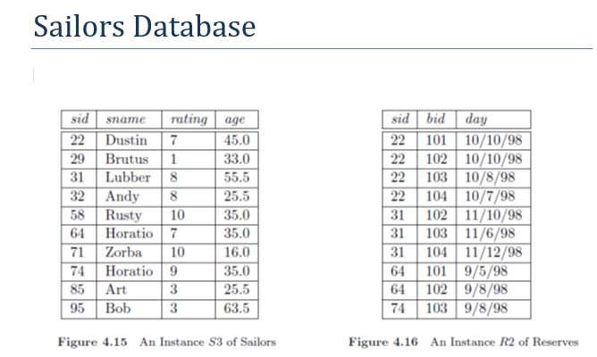
CREATE VIEW ActiveSailors (name, age, day)
AS SELECT S.sname, S.age, R.day
FROM Sailors S, Reserves R
WHERE S.name=R.sname AND S.rating>6

Slide 81
Role-Based Authorization
In SQL-92, privileges are actually assigned to authorization ids, which can denote a single user or a group of users.
In SQL:1999 (and in many current systems), privileges are assigned to roles.
Roles can then be granted to users and to other roles.
Reflects how real organizations work.
Illustrates how standards often catch up with “de facto” standards embodied in popular systems.

Slide 82
Introduction to DB Security
Secrecy: Users shouldn’t be able to see things they are not supposed to.
E.g., A student can’t see other students’ grades.
Integrity: Users shouldn’t be able to modify things they are not supposed to.
E.g., Only instructors can assign grades.
Availability: Users should be able to see and modify things they are allowed to.

Slide 83
Discretionary Access Control
Based on the concept of access rights or privileges for objects (tables and views), and mechanisms for giving users privileges (and revoking privileges).
Creator of a table or a view automatically gets all privileges on it.
DMBS keeps track of who subsequently gains and loses privileges.

Slide 84
GRANT Command
GRANT privileges ON object TO users [WITH GRANT OPTION]
The following privileges can be specified:
SELECT Can read all columns
including those added later via ALTER TABLE command
INSERT(column-name) Can insert tuples with non-null or nondefault values in this column.
INSERT means same right with respect to all columns.
DELETE Can delete tuples.
REFERENCES (column-name) Can define foreign keys (in other tables) that refer to this column.
If you want the recipient(s) to be able to pass the privilege(s) to others add:
WITH GRANT OPTION

Slide 85
Grant Examples I
Suppose Joe has created the tables
Sailors(sid, sname, rating, age)
Boats(bid, bname, color)
Reserves(sid, bid, day)
Joe now executes the following:
GRANT INSERT, DELETE ON Reserves TO Yuppy WITH GRANT OPTION;
Yuppy can now insert or delete Reserves rows and authorize someone else to do the same.

Slide 86
Grant Examples II
Joe further executes:
GRANT SELECT ON Reserves TO Michael;
GRANT SELECT ON Sailors TO Michael WITH GRANT OPTION;
Michael can now execute SELECT queries on Sailors and Reserves, and he can pass this privilege to others for Sailors but not for Reserves.
With the SELECT privilege, Michael can create a view that accesses the Sailors and Reserves tables, for example, the ActiveSailors view:
CREATE VIEW ActiveSailors (name, age, day) AS
SELECT S.sname, S.age, R.day
FROM Sailors S, Reserves R
WHERE S.sid = R.sid AND S.rating > 6;
However, Michael cannot grant SELECT on ActiveSailors to others. Why?
A user who creates a view has precisely those privileges on the view that he has on every one of the views or base tables used to define the view.
Since Michael doesn't have a privilege to grant SELECT on Reserves he can't grant SELECT on ActiveSailors.

Slide 87
Grant Examples III
On the other hand, suppose that Michael creates the following view:
CREATE VIEW YoungSailors (sid, age, rating) AS
SELECT S.sid, S.age, S.rating
FROM Sailors S
WHERE S.age < 18;
The only underlying table is Sailors, for which Michael has SELECT with grant option. Therefore he can pass this on to Eric and Guppy:
GRANT SELECT ON YoungSailors TO Eric, Guppy;
Eric and Guppy can now execute SELECT queries on view YoungSailors.
Note, however, that Eric and Guppy don’t have the right to execute SELECT queries directly on the underlying Sailor table.

Slide 88
Grant Examples IV
Suppose now Joe executes:
GRANT UPDATE (rating) ON Sailors TO Leah;
Leah can update only the rating column of Sailors. E.g.
UPDATE Sailors S
SET S.rating = 8;
However, she cannot execute:
UPDATE Sailors S
SET S.age = 25;
She cannot execute either:
UPDATE Sailors S
SET S.rating = S.rating-l;
Why?

Slide 89
Grant Examples V
Suppose now that Joe executes:
GRANT SELECT, REFERENCES(bid) ON Boats TO Bill;
Bill can then refer to the bid column of Boats as a foreign key in another table. E.g.
CREATE TABLE BillTable (
bid INTEGER,
…
FOREIGN KEY (bid) REFERENCES Boats
);
But, why the SQL standard chose to introduce the REFERENCES privilege rather than to simply allow the SELECT privilege to be used when creating a Foreign Key?

Slide 90
REFERENCES Privilege
To see why, consider the case when the creator of table BillTable (i.e. Bill) doesn’t specify a policy such as for example
ON DELETE SET NULL
The default NO ACTION policy is assumed which prevents Joe from deleting a tuple from Boats because a tuple in BillTable refers to this Boat tuple.
Giving Bill, the creator of the BillTable, the right to constrain deletes (and updates) in this manner goes beyond simply allowing him to read values, which is all that SELECT privilege authorizes.

Slide 91
Role-Based Authorization
Privileges can also be assigned to roles.
Roles can then be granted to users and to other roles.
Reflects how real organizations work.
Example.
CREATE ROLE some_role;
GRANT SELECT ON Reserves TO some_role;
GRANT INSERT ON Sailors TO some_role;
GRANT UPDATE ON Boats TO some_role;
GRANT some_role TO Michael;
GRANT some_role TO Bill;

Slide 92
Revoke Examples I
REVOKE [GRANT OPTION FOR] privileges
ON object FROM users {RESTRICT | CASCADE}
Suppose Joe is the creator of Sailors.
GRANT SELECT ON Sailors TO Art WITH GRANT OPTION
(executed by Joe)
GRANT SELECT ON Sailors TO Bob WITH GRANT OPTION
(executed by Art)
REVOKE SELECT ON Sailors FROM Art CASCADE
(executed by Joe)

Slide 93
Revoke Examples II
Art loses the SELECT privilege on Sailors.
Then Bob, who received this privilege from Art, and only Art, also loses this privilege.
Bob’s privilege is said to be abandoned
When CASCADE is specified, all abandoned privileges are also revoked
Possibly causing privileges held by other users to become abandoned and thereby revoked recursively.
If the RESTRICT keyword is specified, the command is rejected if revoking privileges causes other privileges becoming abandoned.

Slide 94
Revoke Examples III
Joe executes:
GRANT SELECT ON Sailors TO Art WITH GRANT OPTION
Joe executes:
GRANT SELECT ON Sailors TO Bob WITH GRANT OPTION
Art executes:
GRANT SELECT ON Sailors TO Bob WITH GRANT OPTION
Joe executes:
REVOKE SELECT ON Sailors FROM Art CASCADE
As before, Art loses the SELECT privilege on Sailors.
But what about Bob?
Bob received this privilege from Art, but he also received it independently from Joe. So, he doesn’t lose the privilege.

Slide 95
Revoke Examples IV
Joe executes:
GRANT SELECT ON Sailors TO Art WITH GRANT OPTION
GRANT SELECT ON Sailors TO Art WITH GRANT OPTION
REVOKE SELECT ON Sailors FROM Art CASCADE
Since Joe granted the privilege to Art twice and only revoked it once, does Art get to keep the privilege?
As per the SQL, NO. It doesn’t matter how many times we grant a privilege.

Slide 96
Privilege Descriptors
When a GRANT is executed, a privilege descriptor is added to a table of such descriptors maintained by the DBMS.
The privilege descriptor specifies the:
grantor of the privilege,
grantee who receives the privilege,
granted privilege
grant option
When a user creates a table or view he 'automatically' gets privileges,
A privilege descriptor with system as the grantor is entered into the descriptors table.

Slide 97
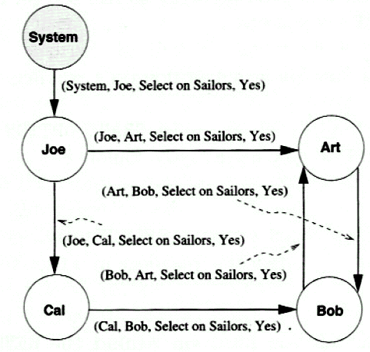
Authorization Graphs
Nodes are users. Arcs indicate how privileges are passed.
GRANT SELECT ON Sailors TO Art WITH GRANT OPTION
(executed by Joe)
GRANT SELECT ON Sailors TO Bob WITH GRANT OPTION
(executed by Art)
GRANT SELECT ON Sailors TO Art WITH GRANT OPTION
(executed by Bob)
GRANT SELECT ON Sailors TO Cal WITH GRANT OPTION
(executed by Joe)
GRANT SELECT ON Sailors TO Bob WITH GRANT OPTION
(executed by Cal)

Slide 98
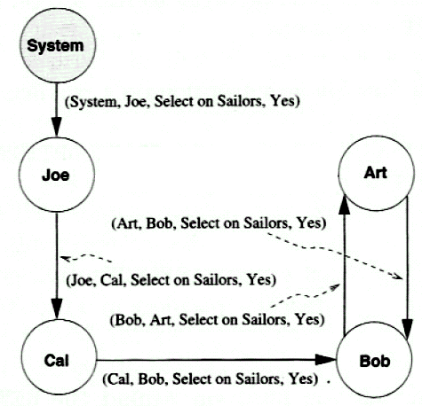
Effects of Revocations I
Suppose that Joe executes:
REVOKE SELECT ON Sailors FROM Art CASCADE
The arc from Joe to Art is removed.
Art still has the privilege
He got it independently from Bob.

Slide 99
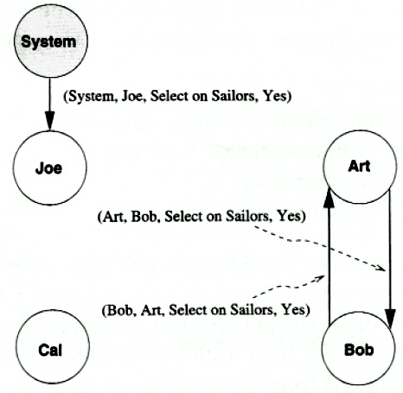
Effects of Revocations II
Let’s suppose now that Joe decides to revoke Cal's SELECT privilege as well.
The arc from Joe to Cal is removed.
The arc from Cal to Bob is removed as well, since there is no longer a path from System to Cal.
Art and Bob also have lost privileges as well because there isn’t a path from the System.

Slide 100
Grant and Revoke on Views
Suppose that Joe created Sailors and gave Michael the SELECT privilege on it with the grant option.
Michael then created the view YoungSailors and gave Eric the SELECT privilege on YoungSailors.
Eric now defines a view called FineYoungSailors:
CREATE VIEW FineYoungSailors (name, age, rating) AS
SELECT S.sname, S.age, S.rating
FROM YoungSailors S
WHERE S.rating> 6;
What happens if Joe revokes the SELECT privilege on Sailors from Michael?
Michael no longer has the authority to execute the query used to define YoungSailors because the definition refers to Sailors.
Therefore, the view YoungSailors is dropped (I.e., destroyed).
In turn, FineYoungSailors is dropped as well.

Slide 101
Revoking REFERENCES privilege
Recall, Joe had executed:
GRANT REFERENCES(bid) ON Boats TO Bill;
Bill referred to the bid column of Boats as a foreign key in BillTable table.
CREATE TABLE BillTable (
bid INTEGER,
…
FOREIGN KEY (bid) REFERENCES Boats
);
If now Joe revokes the REFERENCES privilege from Bill,
then the Foreign Key constraint referencing the Boat table will be dropped from the Bill’s Reserves table.

Slide 102
Mandatory Access Control
Based on system-wide policies that cannot be changed by individual users.
Each DB object is assigned a security class.
Each subject (user or user program) is assigned a clearance for a security class.
Rules based on security classes and clearances govern who can read/write which objects.
Most commercial systems do not support mandatory access control. Versions of some DBMSs do support it; used for specialized (e.g., military) applications.

Slide 103
Why Mandatory Control?
Discretionary control has some flaws, e.g., the Trojan horse problem:
John creates table Heroes and gives INSERT privileges to Justin (who doesn’t know about this).
John modifies the code of an application program used by Justin to additionally write some secret data to table Heroes.
Now, John can see the secret info.
The modification of the code is beyond the DBMS’s control, but it can try and prevent the use of the database as a channel for secret information.

